Slide 1
Synapse Databricks Sync
Importing your Databricks metastore to Synapse
Bret Myers
Microsoft Analytics GBB
https://www.linkedin.com/in/bretamyers

Slide 2
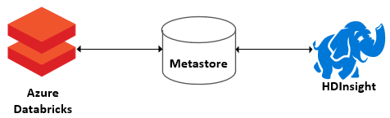
What is a Hive Metastore
Contains the collection of databases, views, tables, columns
This includes the partitions and location to where the data is stored
In Azure Databricks, you can use the internal metastore or define an external metastore to store this information
An external metastore being shared

Slide 3
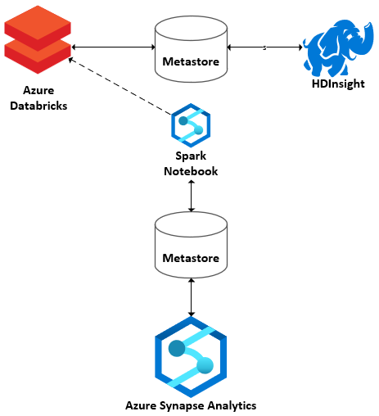
Databricks Metastore Sync to Synapse
Connect to an Azure Databricks cluster
Pull the database tables and view definitions
Execute the definitions in your Synapse spark pool

Slide 4
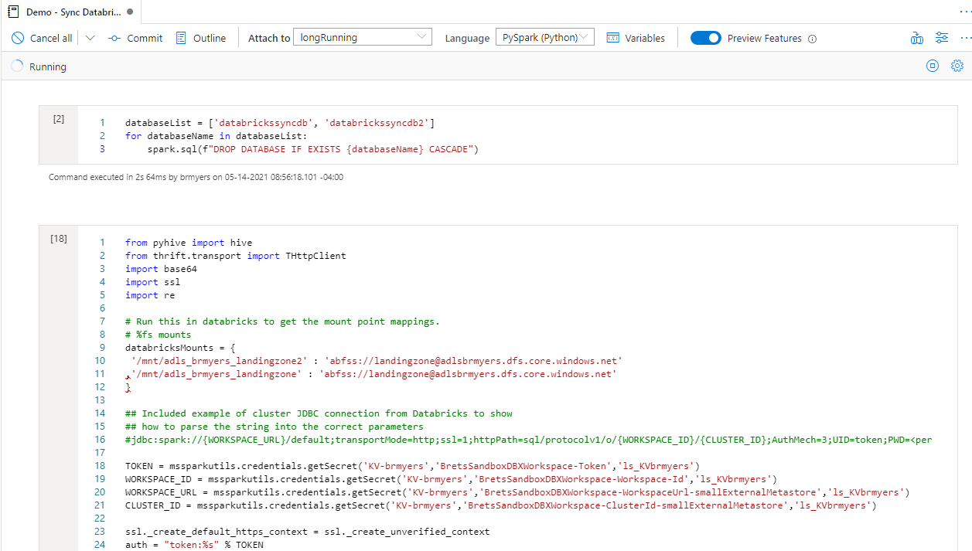
Demo

